Slide 1
Introduction to probablity

Slide 2
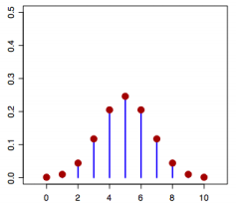
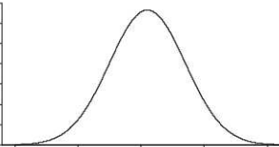
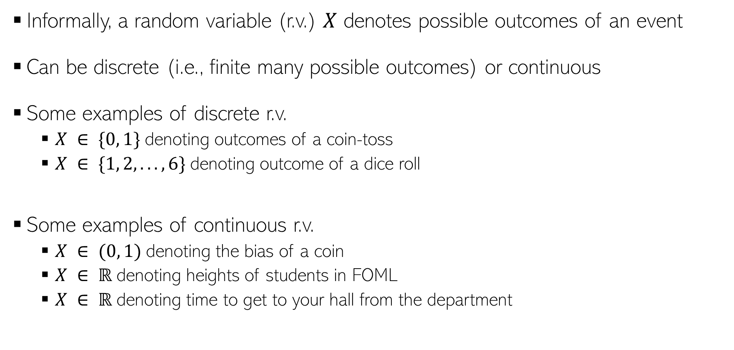
Random Variables
Informally, a random variable (r.v.) $X$ denotes possible outcomes of an event
Can be discrete (i.e., finite many possible outcomes) or continuous
Some examples of discrete r.v.
$X ∈ \{0, 1\}$denoting outcomes of a coin-toss
$X ∈ \{1, 2, . . . , 6\}$denoting outcome of a dice roll
Some examples of continuous r.v.
$X ∈ (0, 1)$denoting the bias of a coin
$X ∈ ℝ$denoting heights of students in FOML
$X ∈ ℝ$denoting time to get to your hall from the department
$$p(X)$$
$X$(a discrete r.v.)
$$p(X)$$
$X$(a continuous r.v.)

Slide 3
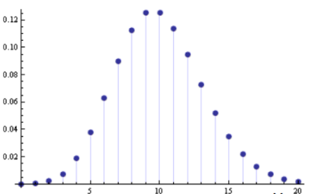
Discrete Random Variables
For a discrete r.v.$X$, $p(x)$ denotes $p(X = x)$ - probability that $X = x$
$p(X)$ is called the probability mass function (PMF) of r.v.$X$
$p(x)$ or $p(X = x)$ is the value of the PMF at $x$
$$p\left(x\right)≥0$$
$$p\left(x\right)≤ 1$$
$$\sum_{x}{p\left(x\right)=1}$$
$$p(X)$$
$$X$$

Slide 4
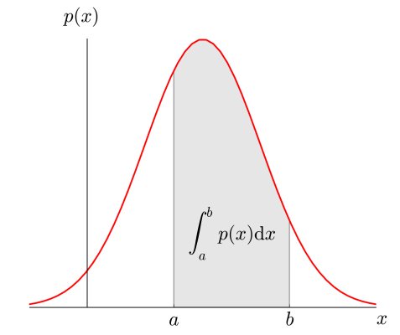


Continuous Random Variables
For a continuous r.v.$X$, a probability$p(X = x)$ or $p(x)$ is meaningless
For cont. r.v., we talk in terms of prob. within an interval$X ∈(a,b)$
$p(x)$ is the probability density at $X= x$
$$p\left(x\right)≥0$$
$$\int{p\left(x\right)dx=1}$$

Slide 5
Discrete example: roll of a die
p(x)
1/6
x
1
2
3
4
5
6

Slide 6
Probability mass function (pmf)
x
p(x)
1
p(x=1)=1/6
2
p(x=2)=1/6
3
p(x=3)=1/6
4
p(x=4)=1/6
5
p(x=5)=1/6
6
p(x=6)=1/6

Slide 7
Cumulative distribution function
x
P(x≤A)
1
P(x≤1)=1/6
2
P(x≤2)=2/6
3
P(x≤3)=3/6
4
P(x≤4)=4/6
5
P(x≤5)=5/6
6
P(x≤6)=6/6

Slide 8
Cumulative distribution function (CDF)
1.0
P(x)
5/6
2/3
1/2
1/3
1/6
1
2
3
4
5
6
x

Slide 9
Practice Problem
The number of patients seen in a clinic in any given hour is a random variable represented by x. The probability distribution for x is:
x
10
11
12
13
14
P(x)
.4
.2
.2
.1
.1
Find the probability that in a given hour:
a. exactly 14 patients arrive
b. At least 12 patients arrive
c. At most 11 patients arrive
p(x=14)= .1
p(x≥12)= (.2 + .1 +.1) = .4
p(x≤11)= (.4 +.2) = .6

Slide 10
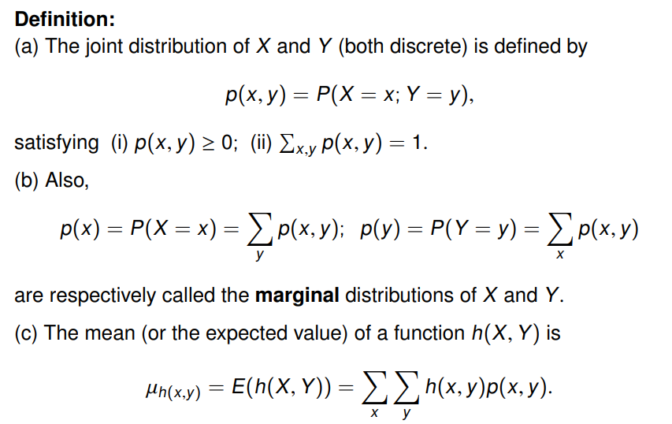
Joint Probability Distribution

Slide 11
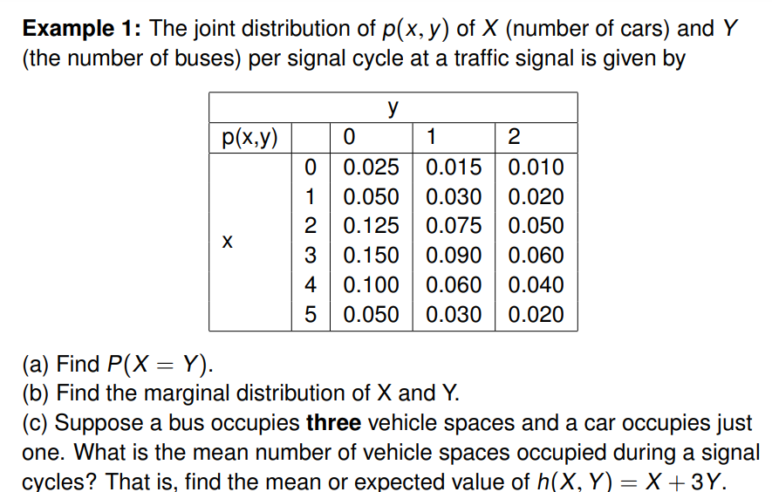

Slide 12
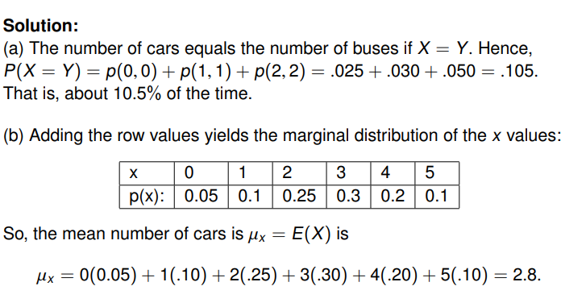

Slide 13
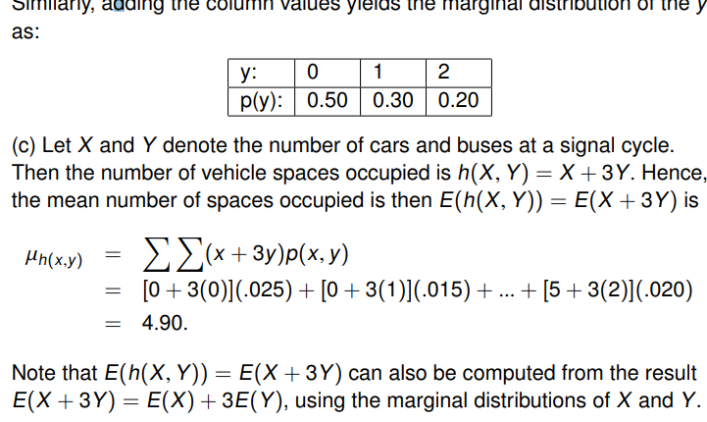

Slide 14
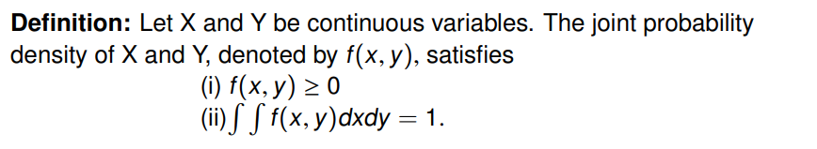
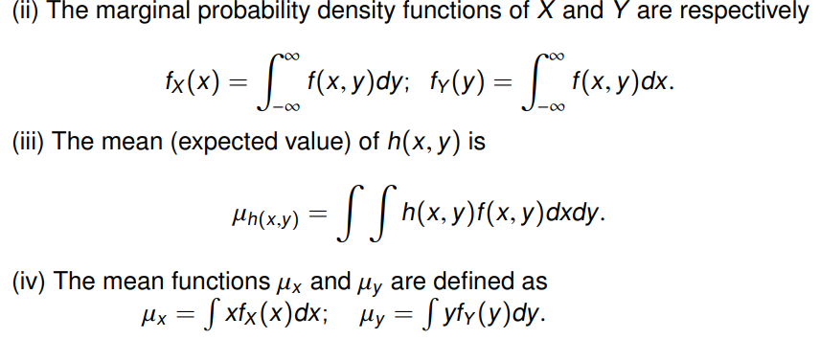
Continuous case

Slide 15
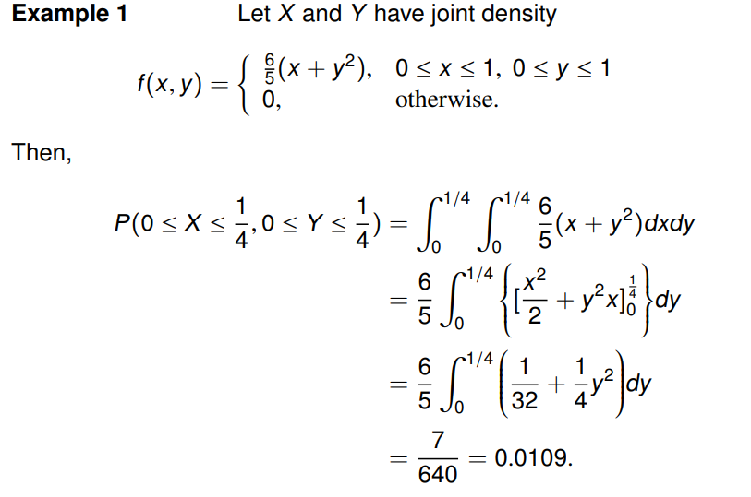

Slide 16
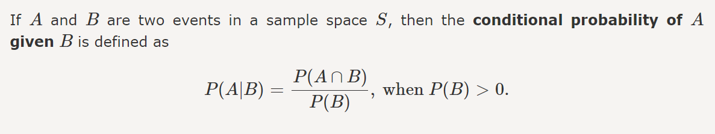
Conditional Probability
Conditional Probability for Independent Events
Two events are independent if the probability of the outcome of one event does not influence the probability of the outcome of another event
P(A|B) = P(A)
P(B|A) = P(B)
Conditional Probability for Mutually Exclusive Events
In probability theory, mutually exclusive events are events that cannot occur simultaneously. In other words, if one event has already occurred, another can event cannot occur. Thus, the conditional probability of mutually exclusive events is always zero.
P(A|B) = 0
P(B|A) = 0

Slide 17
Example : -A bag contains green and yellow balls. Two balls are drawn without replacement. The probability of selecting a green ball and then a yellow ball is 0.28. The probability of selecting a green ball on the first draw is 0.5. Find the probability of selecting a yellow ball on the second draw, given that the first ball drawn was green.
Solution: Let A and B be the events of drawing a green in the first draw and yellow ball in the second draw respectively. From the given, P(A) = 0.5 P(A ⋂ B) = 0.28 Probability of selecting a yellow ball on the second draw, given that the first ball drawn was green = Conditional of B given A = P(B|A) = P(A ⋂ B)/P(A) = 0.28/0.5 = 0.56

Slide 18


Example : In a class, 35% of the students study Machine Learning and computer Security . 65% of the students study Machine learning . What is the probability of a student studying Computer security given he/she is already studying Machine Learning ?
Solution
Percentage of the students studying Machine Learning and Computer Security= 35%
Probability of students studying Machine Learning and Computer Security = P(M and C) = 0.35
Percentage of students studying Machine Learning = 65%
The probability of students studying Machine Learning = P(M) = 0.65
$P\left(M | C\right)=\frac{P(M and C)}{P(M)}$ =$\frac{0.35 }{0.65}$
$$=0.53$$

Slide 19
The Chain Rule of Conditional Probabilities
• Any joint probability distribution over many random variables may be decomposed into conditional distributions over only one variable

Slide 20
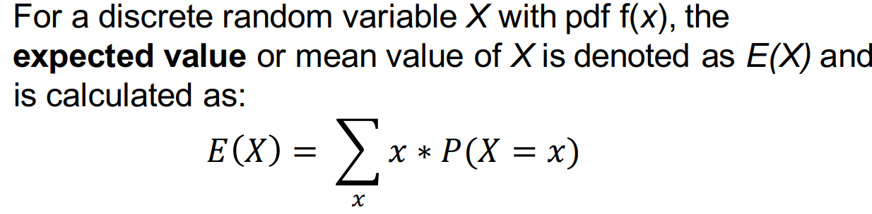
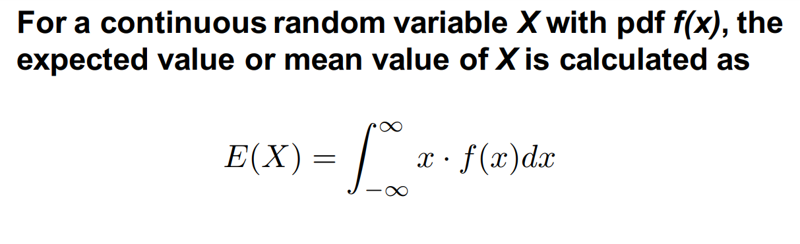
Mean (Expected Value) of X

Slide 21
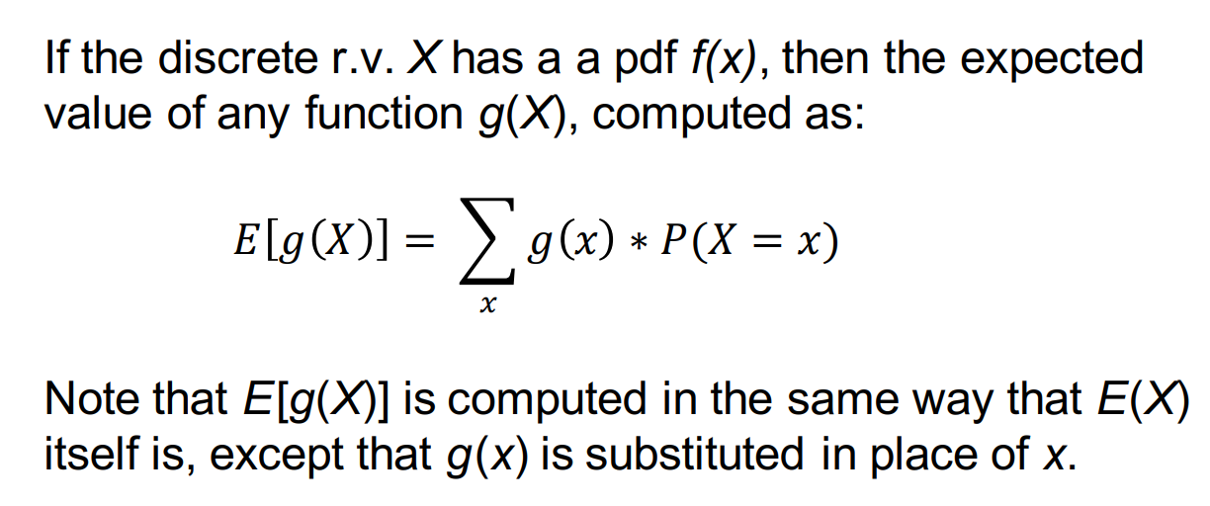
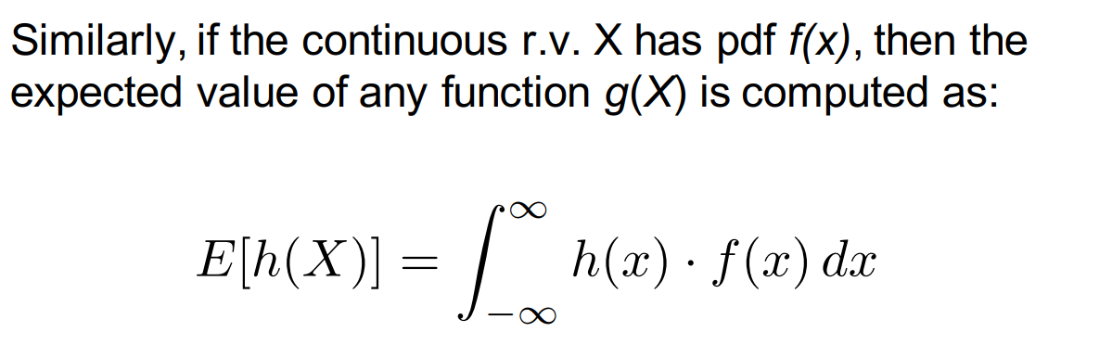
The Expected Value of a Function

Slide 22
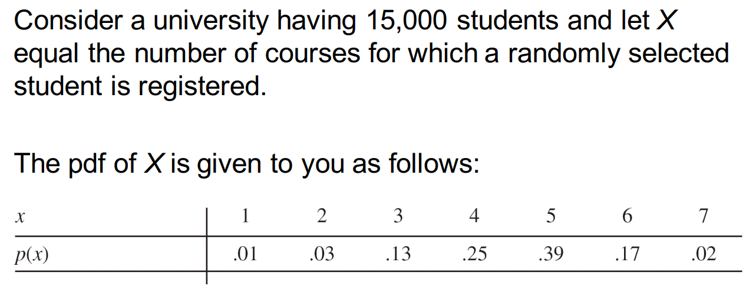
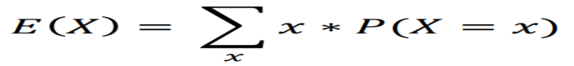
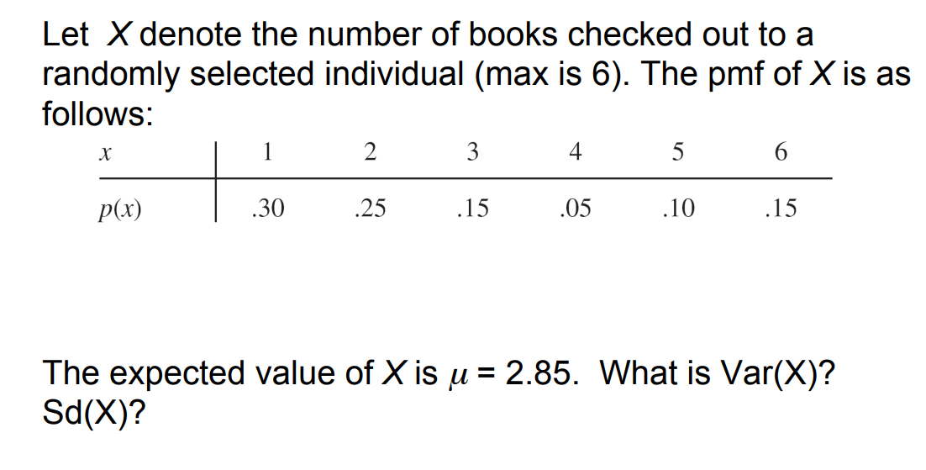
Example : Consider a university having 15,000 students and let X equal the number of courses for which a randomly selected student is registered. The pdf of X is given to you as follows:
What is E(X)?

Slide 23
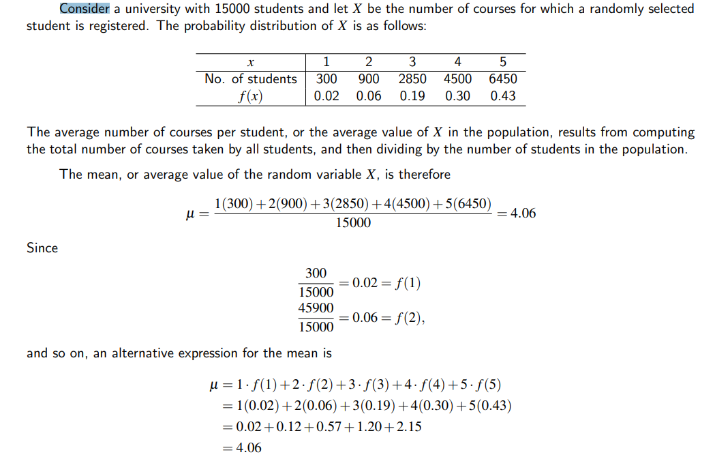

Slide 24
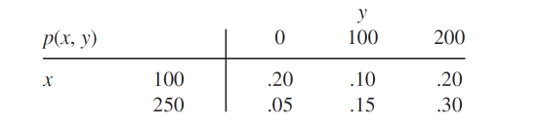
Example: - An insurance agency has customers with both home and auto policy. For each type of policy, a deductible amount must be specified. For auto policy, choices are $100 and $250, for home policy, choices are $0, $100, and $200. Suppose a customer is selected at random.
Let: X = his deductible on the auto policy Y = his deductible on the home policy.
All possible values for (X, Y) are then: (100, 0), (100, 100), (100, 200), (250, 0), (250, 100), (250, 200) Suppose the joint pmf is given by the insurance company in the accompanying joint probability table:
What is the probability that X = 100?
p(X=100) = p(100, 0) + p(100, 100) + p(100, 200) = .50
What is the probability that X = 250?
p(X=250) = p(250, 0) + p(250, 100) + p(250, 200) = .50
What is the probability that P(Y>=100) ?
P(Y≥100)=p(100,100)+p(250,100)+p(100,200) +p(250 200)= .75
The conditional pmf of Y given that X = 100 ?
P(Y=0 | X=100) = P(Y=0 & X=100)/P(X=100) = 0.2/0.5 = 40% ; P(Y=100 | X=100) = 0.1/0.5 = 20%
P(Y=200 | X=100) = 0.2/0.5 = 40%
What is the expected value of Y given that X=100
0 * P(Y=0|X=100) + 100 * P(Y=100|X=100) + 200 * P(Y=200|X=100) = 0*.4 + 100*.2 + 200*.4 = 20+80 = 100
Then p(100, 100)=P(X=100 and Y=100) =P($100 deductible on both policies)=.1
https://amath.colorado.edu/faculty/vdukic/4570/week5_handout_2020.pdf

Slide 25
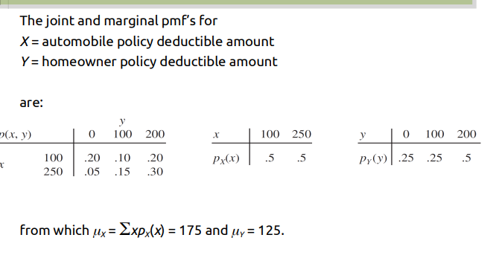
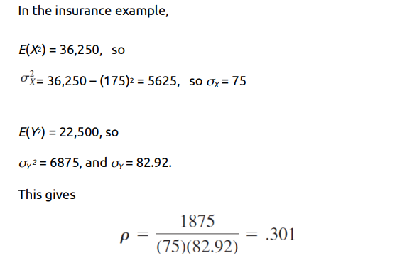
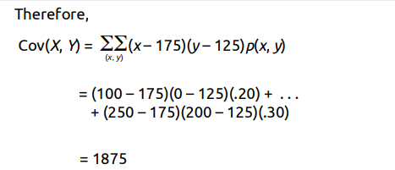

Slide 26
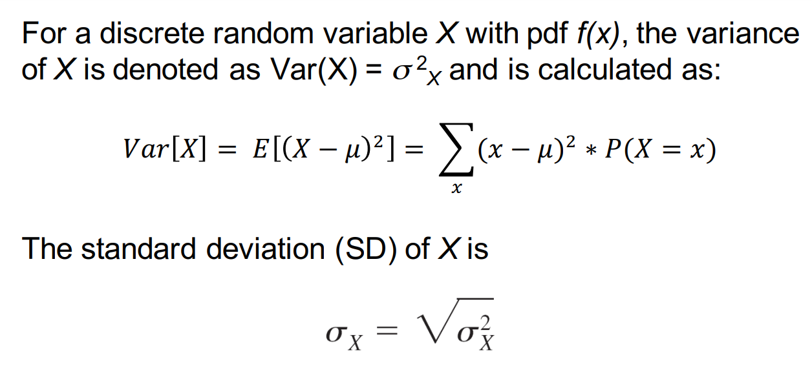
The Variance of X

Slide 27
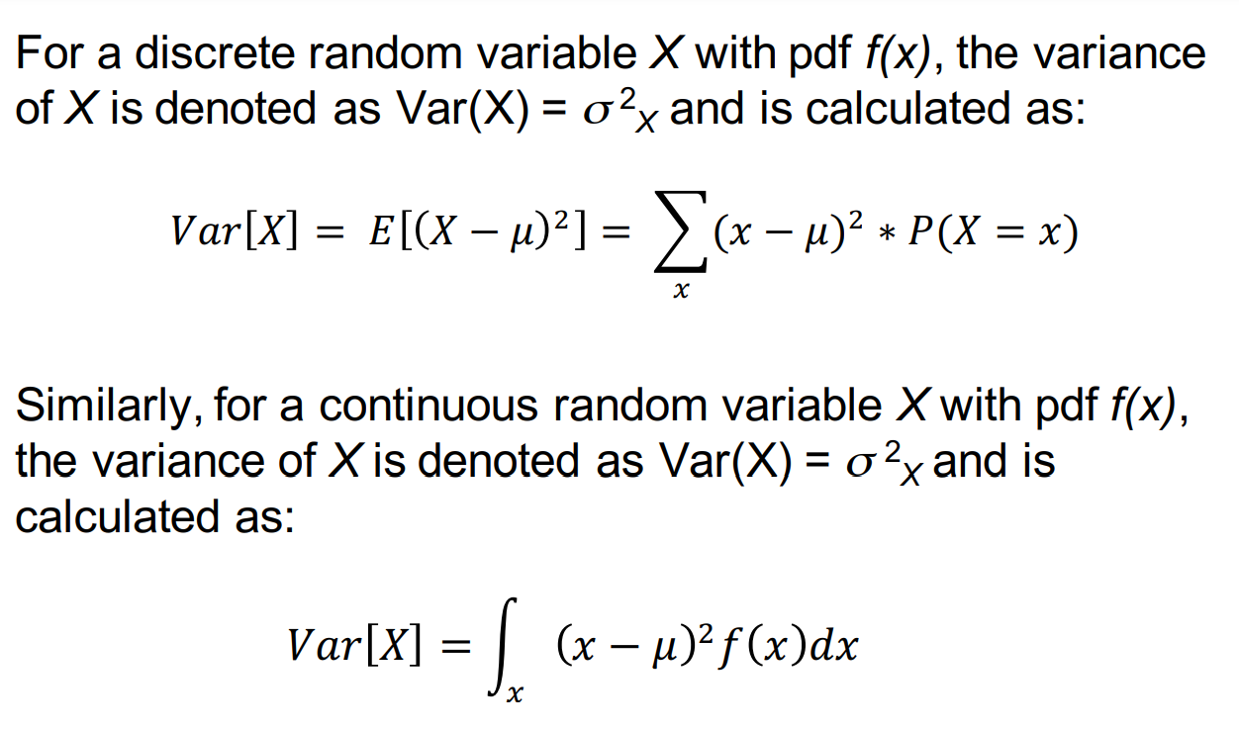

Slide 28
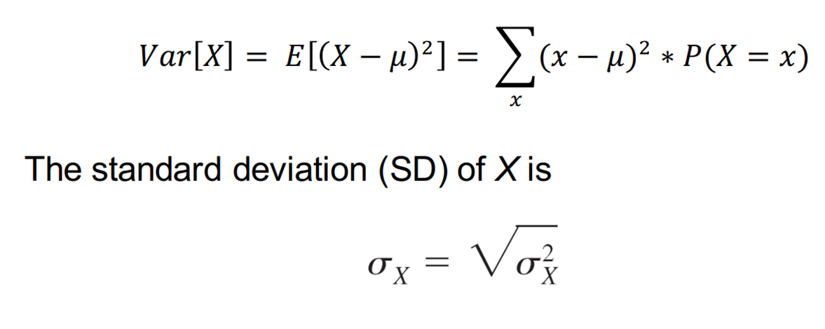
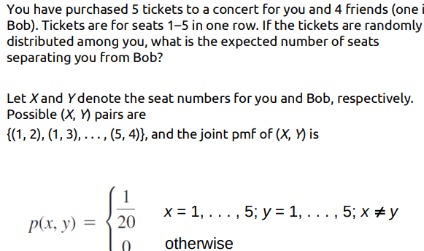
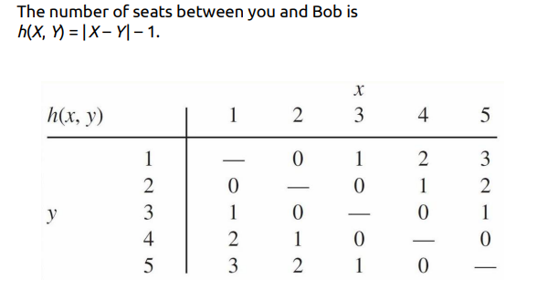
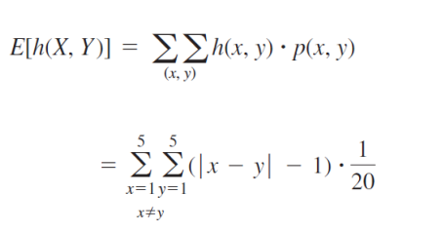
Example :Consider a university having 15,000 students and let X equal the number of courses for which a randomly selected student is registered
The pdf of X is given to you as follows:
What is Var(X)? What about sd(X)?

Slide 29
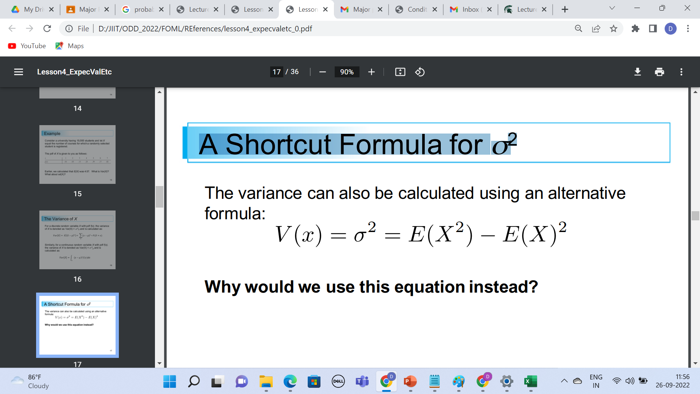
A Shortcut Formula for σ2

Slide 30
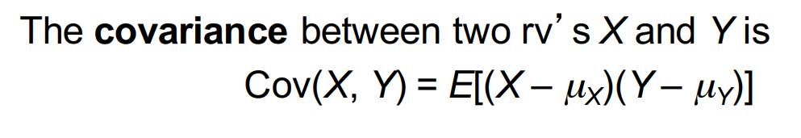
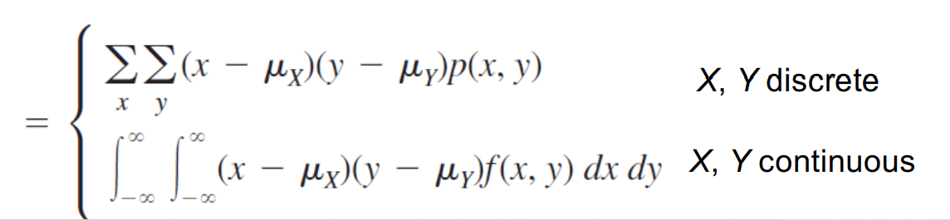
Covariance
When two random variables X and Y are not independent, it is frequently of interest to assess how strongly they are related to one another

Slide 31
If both variables tend to deviate in the same direction (both go above their means or below their means at the same time), then the covariance will be positive.
If the opposite is true, the covariance will be negative.
If X and Y are not strongly related, the covariance will be near 0.

Slide 32
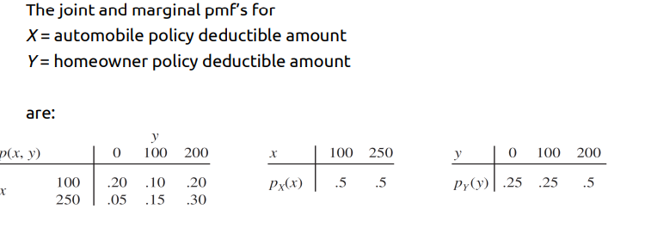

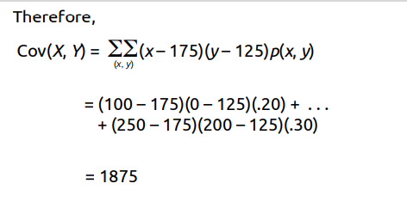
Example :
This is a large positive covariance

Slide 33
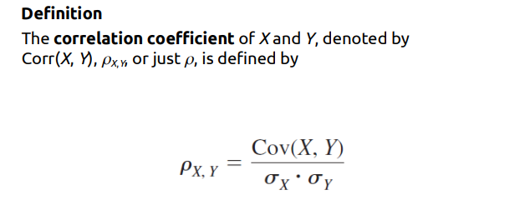
Correlation
It represents a “scaled” covariance – correlation ranges between -1 and 1.
https://amath.colorado.edu/faculty/vdukic/4570/week5_handout_2020.pdf

Slide 34
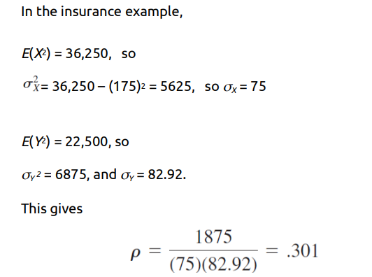
If X and Y are independent, then $ρ$ = 0, but $ρ$= 0 does not imply independence. The correlation coefficient $ρ$ is actually not a completely general measure of the strength of a relationship.

Slide 35
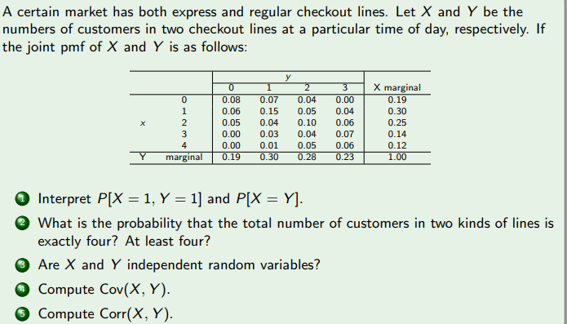

Slide 36
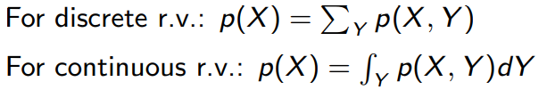
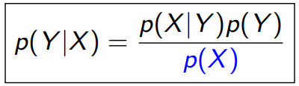
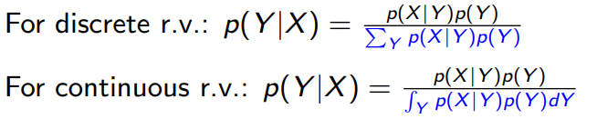
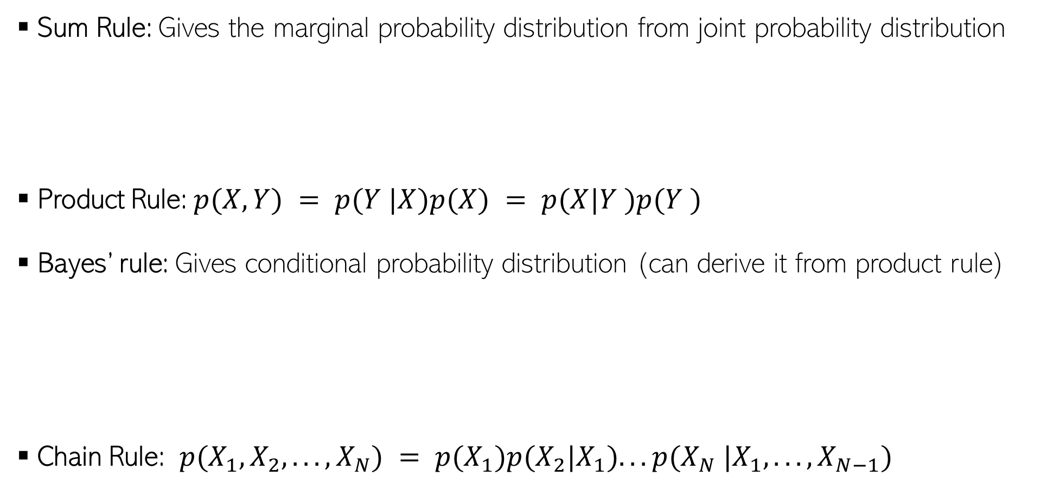
Some Basic Rules
Sum Rule: Gives the marginal probability distribution from joint probability distribution
Product Rule: $p(X, Y) = p(Y |X)p(X) = p(X|Y )p(Y )$
Bayes’ rule: Gives conditional probability distribution (can derive it from product rule)
Chain Rule: $p(X_{1}, X_{2}, . . . , X_{N}) = p(X_{1})p(X_{2}|X_{1}). . . p(X_{N} |X_{1}, . . . , X_{N−1})$

Slide 37


Independence
$X$ and $Y$ are independent when knowing one tells nothing about the other
The above is the marginal independence $(X ⫫ Y)$
Two r.v.’s$X$ and $Y$ may not be marginally indep but may be given the value of another r.v.$Z$

Slide 38
Common Probability Distributions
Important: We will use these extensively to model data as well as parameters of models
Some common discrete distributions and what they can model
Bernoulli: Binary numbers, e.g., outcome (head/tail, 0/1) of a coin toss
Binomial: Bounded non-negative integers, e.g., # of heads in $n$ coin tosses
Multinomial/multinoulli: One of $K$ (>2) possibilities, e.g., outcome of a dice roll
Poisson: Non-negative integers, e.g., # of words in a document
Some common continuous distributions and what they can model
Uniform: numbers defined over a fixed range
Beta: numbers between 0 and 1, e.g., probability of head for a biased coin
Gamma: Positive unbounded real numbers
Dirichlet: vectors that sum of 1 (fraction of data points in different clusters)
Gaussian: real-valued numbers or real-valued vectors

